Slide 1

November 2022
PROJECT HEMP
IN SUB SAHARA AFRICA
TO HELP COMBAT CLIMATE CHANGE
ZAMBEZI ENVIRO T/A HEMP CONSOLIDATED

Slide 2
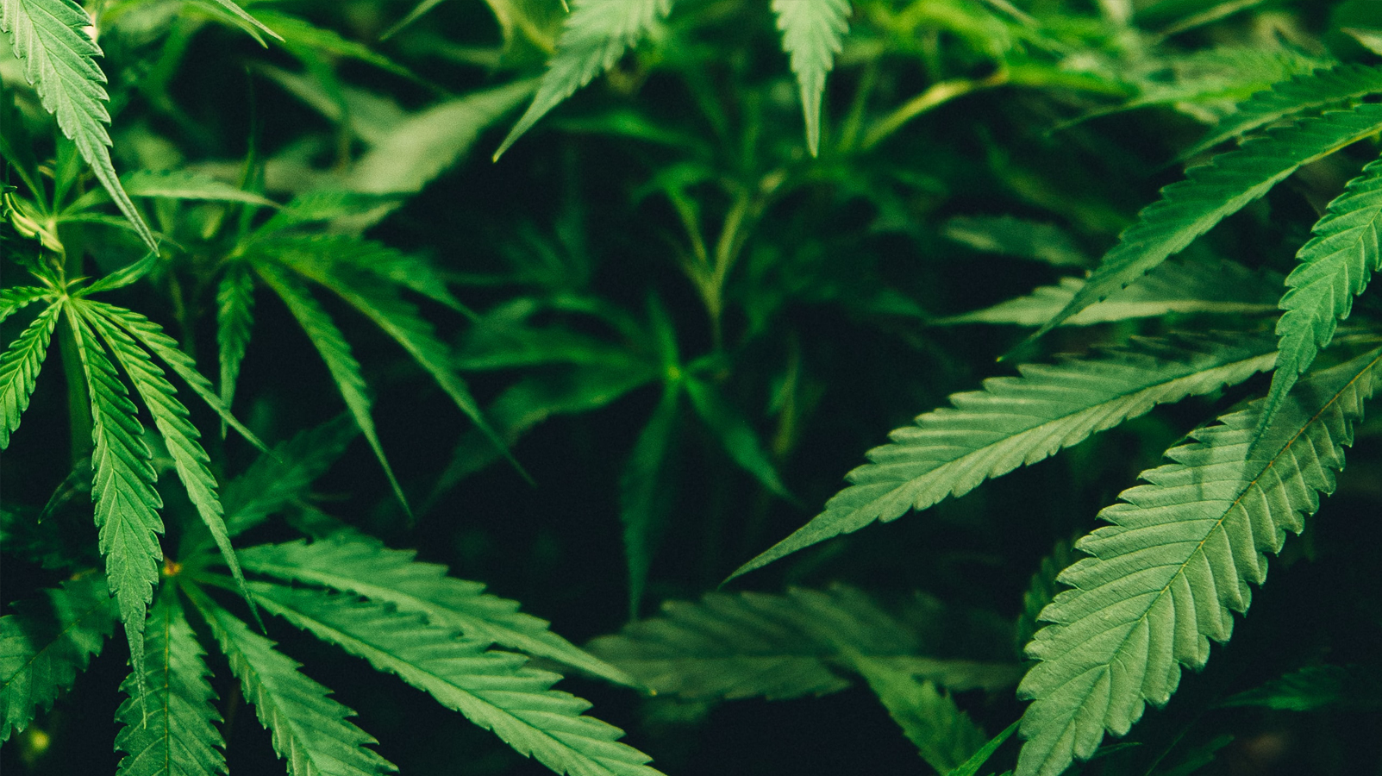
HEMP – THE WONDER PLANT

Slide 3
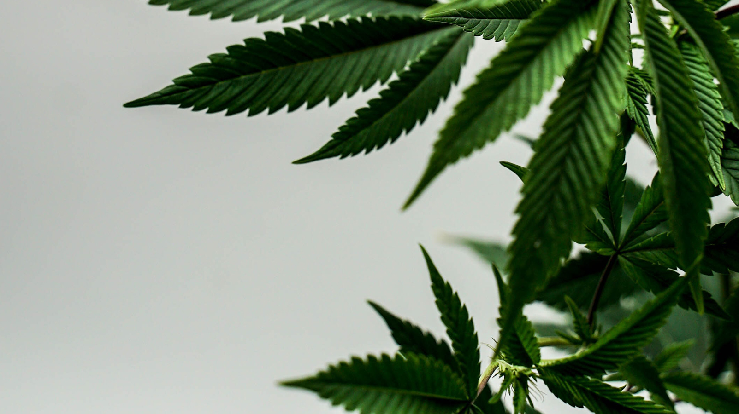
ONE ACRE OF HEMP PRODUCES MORE OXYGEN
THAN TWENTY FIVE ACRES OF FOREST. www.flawsomejen.com
First grown over 12,000 years ago, Hemp can make
more fuel, fibre, food and medicine than any other plant.
A single acre of Hemp can produce 300 gallons of oil,
3 tons of protein and 30 tons of fibre per year.

Slide 4
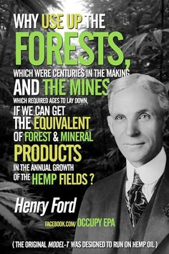
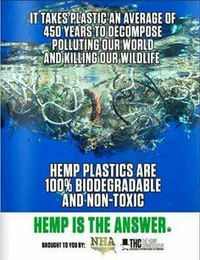
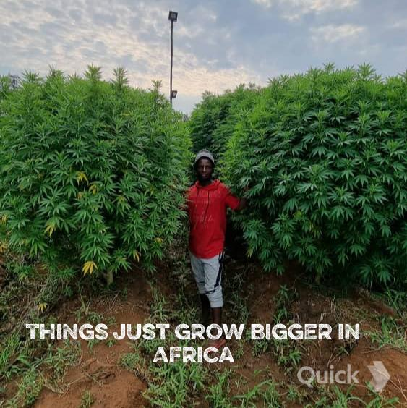

Slide 5
• Hemp requires about half the amount of water that cotton needs.
• Anything made from plastic can be made from Hemp.
• One and a half acres of Hemp produces the same amount of paper as
four and a half acres of trees and takes a fraction of the time to grow.

Slide 6
PROJECT HEMP - REASONS & BENEFITS
Hemp is one of the most environmentally friendly plants on earth and helps us engage
in the global fight against greenhouse gases and the uptake of CO2 into the atmosphere.
Now legal to grow under the Ministry of Agriculture in Zimbabwe and has been removed
from The Dangerous Drug Act, (it does not contain any THC which is the active ingredient
in cannabis that makes it psychoactive), so we can take advantage of a crop that has
once again surfaced on the global markets.
We have the full support of Dr Zoe Maboreke the director of Zimbabwe Hemp Trust.
We have further been in contact with the local Provisional Government Head Quarters in
Mashonaland Central based in the town of Bindura. They have also given us their full support.
We also have support from Central Government in Harare who is keen to see a project of
this magnitude become successful under the Ministry of Agriculture.

Slide 7
PROJECT HEMP - REASONS & BENEFITS
There is a big need to make opportunities for a new cash crop in our country and Africa
as a whole. Many traditional crops offer limited returns as government and multinational
tobacco companies control the prices.
It is our vision to supply seed and fertilizer and offer an up take agreement for every grower,
especially small scale farmers. As hemp is fairly drought resistant and can be harvested by hand
it makes it a unique crop for small traditional family farming units.
This offers a new farming solution in the fight against poverty at the same time as fighting
climate change.

Slide 8
PROJECT HEMP – OUR PITCH

Slide 9
PROJECT HEMP - VISION & GOAL
OUR VISION is to engage in a large production of fibre hemp by utilizing our climate,
soil and expertise and give a meaningful contribution not only in the uptake of CO2
(20ton/hectare) but also to make meaningful eco-friendly products like bio plastic -
such as a unique water bottle, that breaks down within just six weeks - packaging,
paper, insulation and building materials amongst other things.
OUR GOAL is to to start an aggressive planting program of hemp on our farms with
our partners. Zambezi Enviro has access to two farms with over 500 ha of arable land
outside the capital city of Harare. The land includes unlimited water and underground
piping for irrigation, along with basic infrastructure like big sheds, electricity etc.
We can grow 500ha of fibre Hemp x3 annually. With a yield of 5-7ton/ha of biomass
giving a production of ten thousand ton/pa. We also have a network of commercial
farmers who would be interested to come on board to increase production if needed.

Slide 10
PROJECT HEMP – OUR TEAM
Zambezi Enviro is a group of three men who have a vision to bring Hemp production to Zimbabwe and indeed Africa.
KIM BIRKETOFT – CEO has for the last 4 years been actively engaged in studying hemp both
as a fibre crop and also for the extraction of CBD oil. This culminated in a pilot scheme
of 10 ha in 2021.
ROD SWALES is a well-experienced farmer/entrepreneur with years of experience in various tropical crops both agriculture and horticulture. He presently operates Craigside Farms in Mashonaland central province where the project will commence.
OLE LARSEN is a Danish farmer with huge experience in farming and has spent several years running large projects in both Ukraine and Poland. Ole has a huge interest in combating climate change.

Slide 11
PROJECT HEMP – OUR NEED
So what do we need to succeed?
We need help in the form of funding, grants, expertise and uptake of our products.
We have the will and expertise to produce the raw material in huge quantities.
We are now looking for progressive partners who have the same vision as ourselves.
Individuals, Corporate Organizations, Government Organizations and NGOs who see
the potential of a viable eco-friendly crop that will bring us all the right returns.

Slide 12
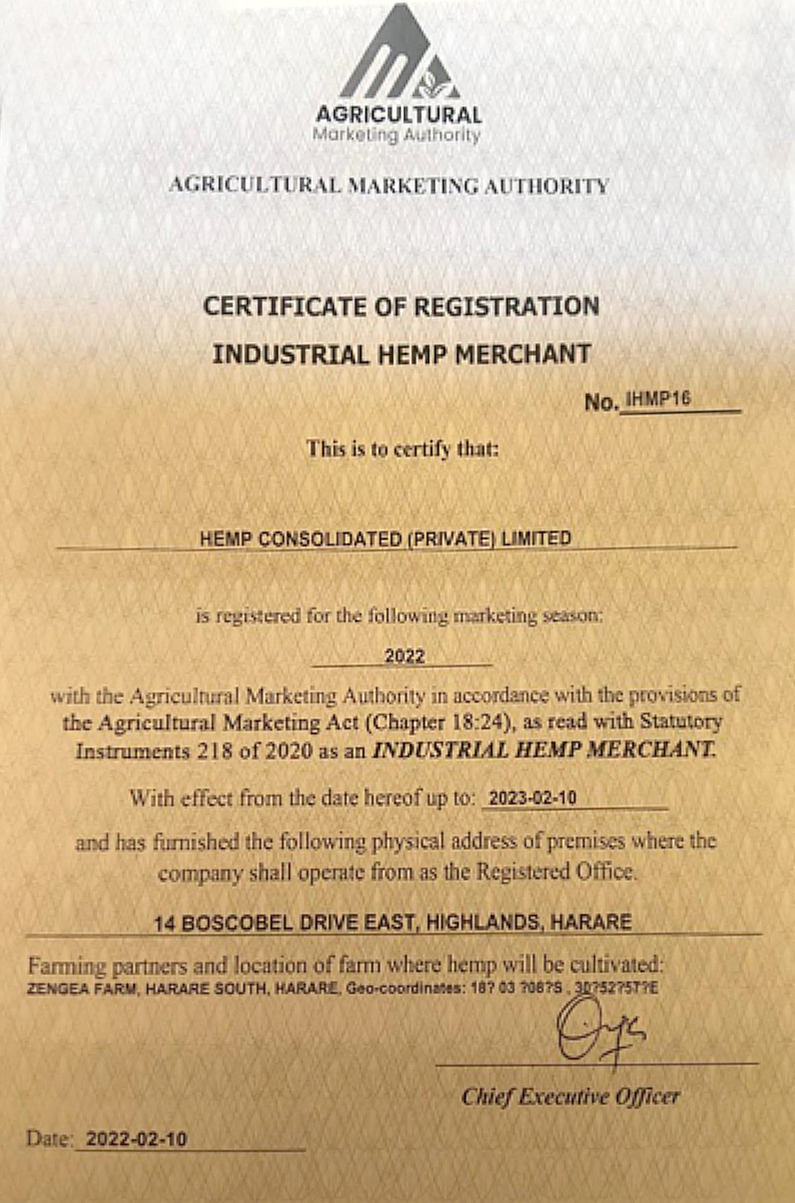
PROJECT HEMP – CERTIFICATE OF REGISTRATION
2

Slide 13
PROJECT HEMP – FINAL WORD

Slide 14
MAKING A DIFFERENCE
At the recent COP27 meeting in Egypt the final communiqué was for the first world countries
to help developing countries fight climate change. It is unclear, as usual, how and when this help
will arrive and in what form.
Zambezi Enviro strongly believes this help and fight must start from within. Africa needs an
opportunity to show it is capable and it can use its own natural resources to help fight against
greenhouse gasses while at the same time fight unemployment, hunger, diseases and poverty.
This is our dream. This is our way of making a difference.

Slide 15
PROJECT HEMP – CONTACT DETAILS

Slide 16
ARE YOU INTERESTED?
2
IF YOU WOULD LIKE TO BE A PART OF THIS PROJECT
YOU CAN REACH US FOR MORE INFORMATION AT:
Email: hempenviro@gmail.com or call +263 (0)772 565 170

Slide 17
THANK YOU
All work in this presentation remains the property of Zambezi Enviro and cannot be used
or replicated in any way without written permission from the company

